Slide 1
Proposed Updates to Market Manual 1.4: Connection Assessment and Approval (CAA) and the CAA Application Form
October 23, 2024
Silviu Motoc - Principal Power System Engineer
Hyun-Joon Kim – Power System Engineer

Slide 2
Key takeaways:
The IESO is taking steps to improve the connection applicants’ experience throughout the CAA process by:
Streamlining the process for qualified Like-for-like replacements by eliminating the need for assessing each individual change. This reduces assessment time and costs for market participants and provides more certainty with future changes.
Simplifying the application process via a new consolidated CAA Application Form that continues to be shared between the IESO and transmitters.
Clarifying when the CAA process is needed and when it is not, and the role of the parties involved in the CAA process.

Slide 3
Background
Market Manual 1.4: establishes the procedures that describe the manner and timing for processing requests for connection assessment.
Application Form: specifies the information a connection applicant must submit to the IESO as part of their connection assessment request. It is a combined SIA* and CIA** form that simplifies the initialization of the CAA process with the IESO and the transmitters.
* System Impact Assessment ** Customer Impact Assessment

Slide 4
Purpose of the presentation
This presentation provides a high-level overview of the proposed updates to Market Manual 1.4 and the CAA Application Form part of Baseline 52.1. It is not intended to describe the process itself or the updates in detail.
Stakeholders are encouraged to review the documents posted within Baseline 52.1 (BL52.1) and submit feedback in writing, for the IESO to consider as part of the Baseline process.
For any questions related to the CAA process, please email to: connection.assessments@ieso.ca.

Slide 5
I. Updates to Market Manual 1.4

Slide 6
Streamlining the Connection Process
Added new section 2.1 for the following process improvements:
Like-for-like replacements: Qualified projects can now initiate their facility registration without needing an SIA. Appendix B outlines which projects qualify and the conditions they must meet.
Blanket SIA: For replacements not covered by Appendix B, the IESO can perform a “blanket” SIA for all future qualifying changes. This approach saves time and costs while providing more certainty for future changes.
Spare Equipment and Maintenance: if the characteristics of the spare or replacement equipment are known, it can be included in the initial SIA for a new facility. This allows the market participant to proceed with the change when needed, though market registration and performance validation are still required.

Slide 7
Streamlining the Connection Process (cont’d)
Software/firmware updates: Qualified projects need only submit the test results to the IESO’s Performance Validation team without needing an SIA. Appendix C outlines which projects qualify and the steps that must be followed when updating the software/firmware of generation or electricity storage controls.
Provision of operating reserve (OR): Exiting embedded# generation or electricity storage facilities that intend to provide OR can now initiate the facility registration process without needing an SIA, though distributor’s approval is still required.
# “Embedded” refers to facilities connected within a distributor’s distribution system, and for the purpose of this change, also include facilities of less than or equal to 10 MW that were not subject to SIA for their original connection. Generation and electricity storage facilities that are directly connected to the IESO-controlled grid (transmission system) are usually assessed and approved for both energy and ancillary services.

Slide 8
Clarifications (Key changes):
New section 7.3: The Connection Applicant: Provides guidance for connection applicants on who must file the CAA application with the IESO based on different connection scenarios
Market Rules References: Each section now includes references to relevant market rules (by section number) and has meaningful bold titles, making it easier to identify specific provisions.
Reorder of Sections: Section 7: Technical Feasibility Studies is now section 9.

Slide 9
II. Updated CAA Application Form

Slide 10
Streamlined CAA Application Form
Consolidates all SIA application forms into single form
It is a fillable PDF that adapts to the needs of each project type
Has built-in data sheets for standard dynamic models
Includes controls for validation and finalization to reduce back and forth communication
Is AODA compliant

Slide 11
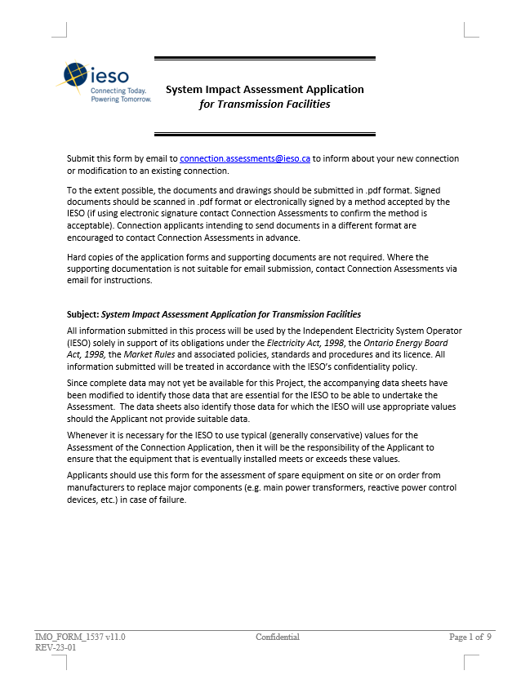
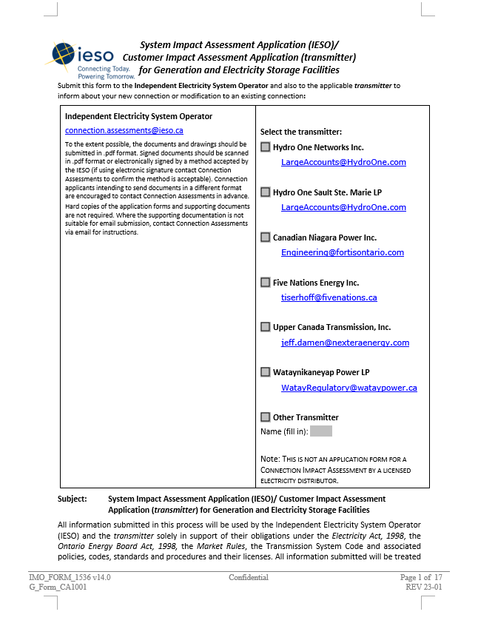
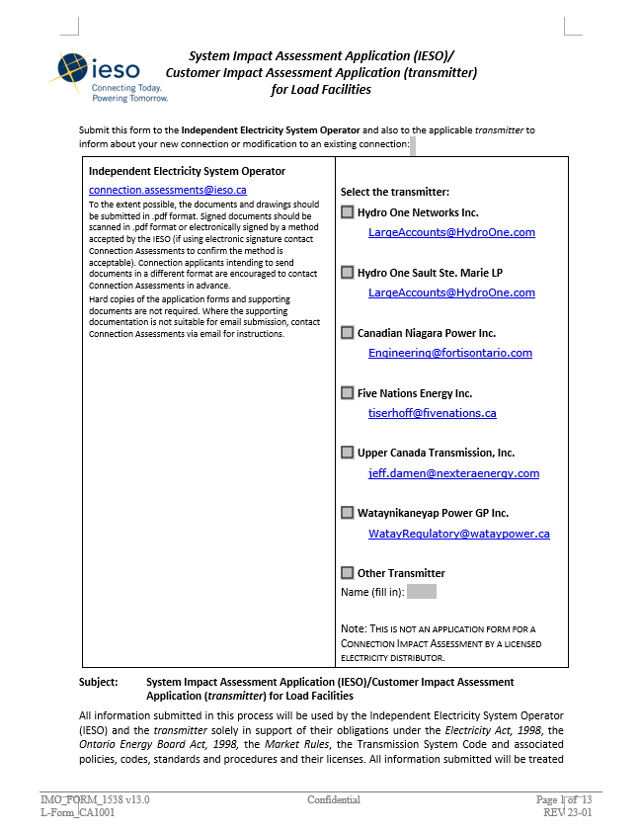
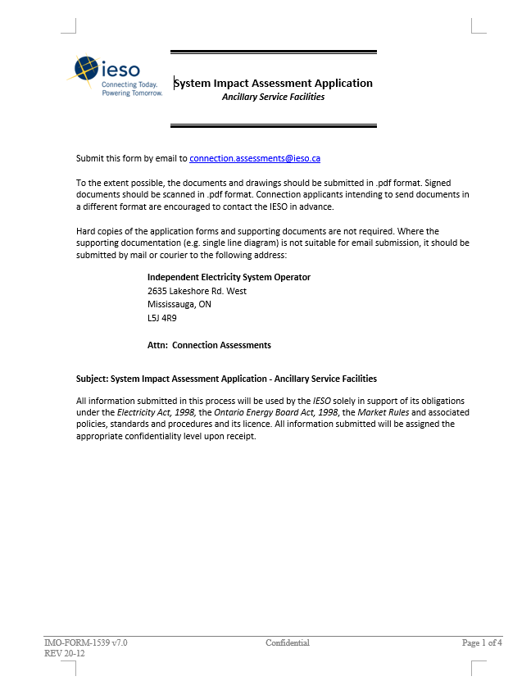
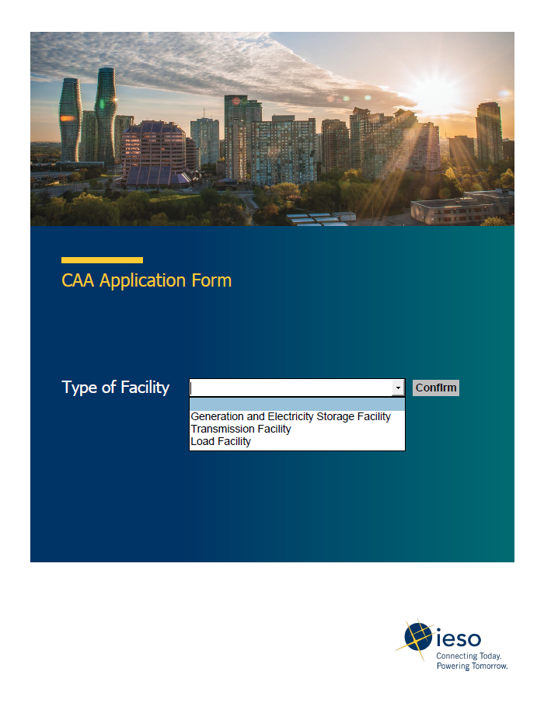
Consolidated CAA Application Form

Slide 12
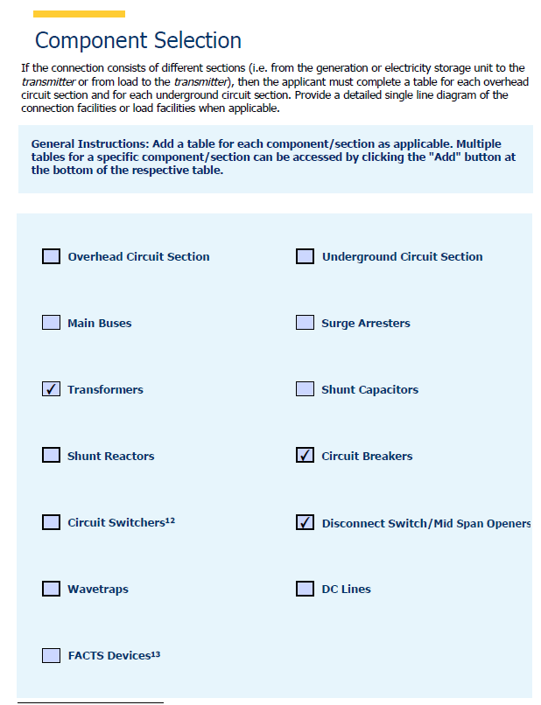
Selection of Components
Dynamic feature to add only the scope related to the project

Slide 13
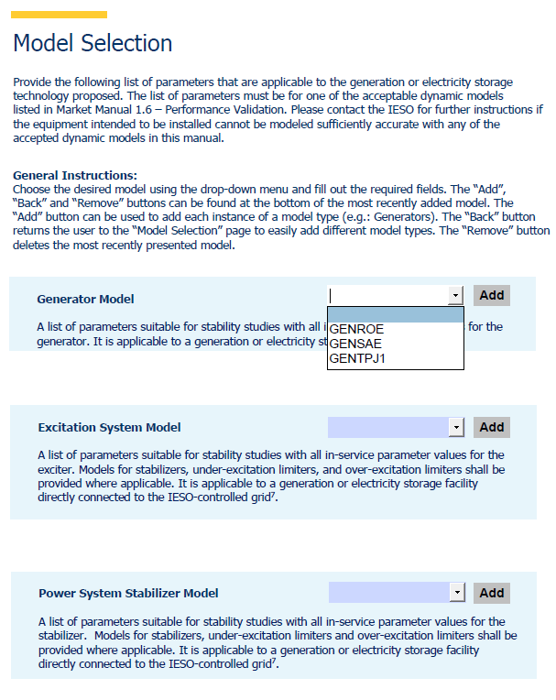
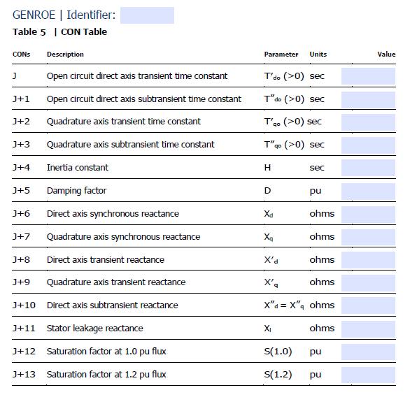
Data Sheets for Dynamic Models
Standardized tables to input data for Dynamic models built in the application form

Slide 14
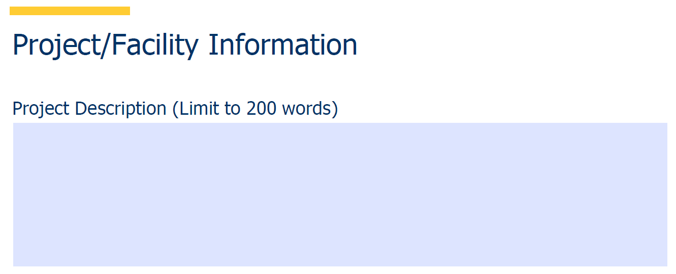
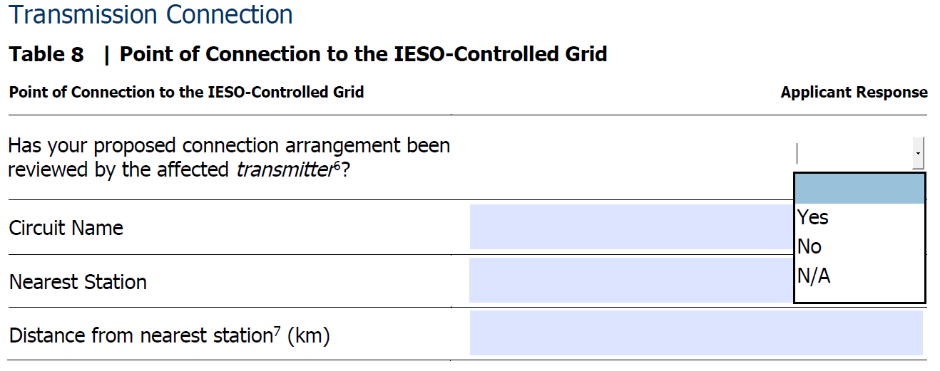
Project Description and Point of Connection
Input field for project description
Updated questionnaire for point of connection- which is a critical path to initiate the CAA process (Reference: MM 1.4)

Slide 15
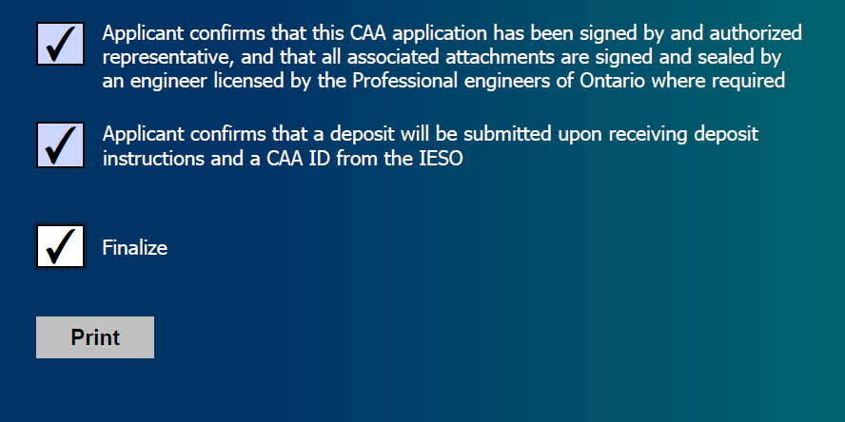
Validation and Finalization
Finalize and Validate Connection Applicant Input Fields
Note: The IESO will continue to accept applications using the existing application forms from those who are currently in process of preparing their application for as long as is needed.

Slide 16
Updated CAA Application Form Demo

Slide 17
Additional Support
• Market Participants are encouraged to reach out to the IESO if they require support.

Slide 18
Thank You
ieso.ca
@IESO_Tweets
1.888.448.7777
linkedin.com/company/IESO
customer.relations@ieso.ca
engagement@ieso.ca

